Slide 1
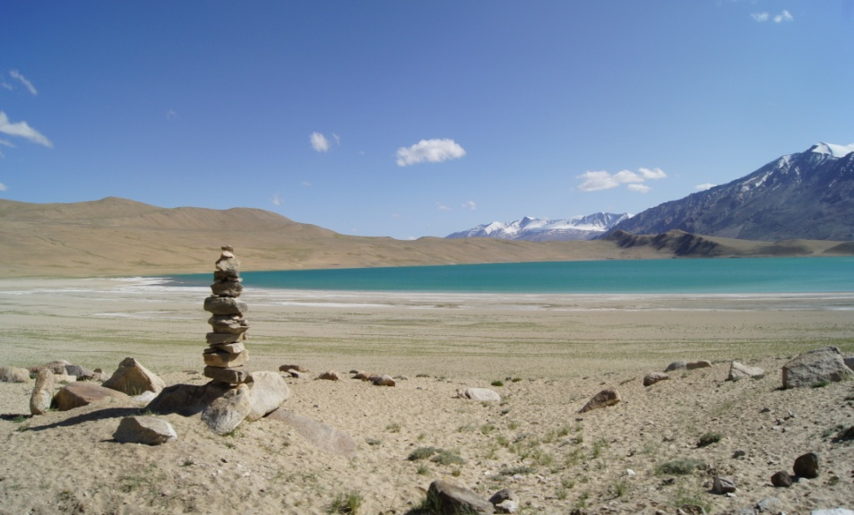
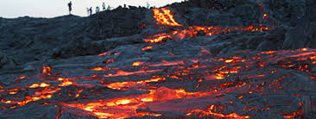
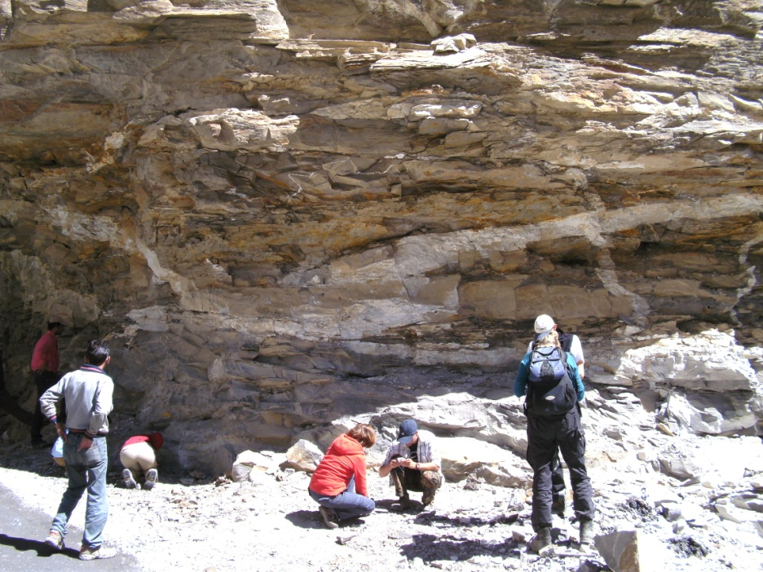
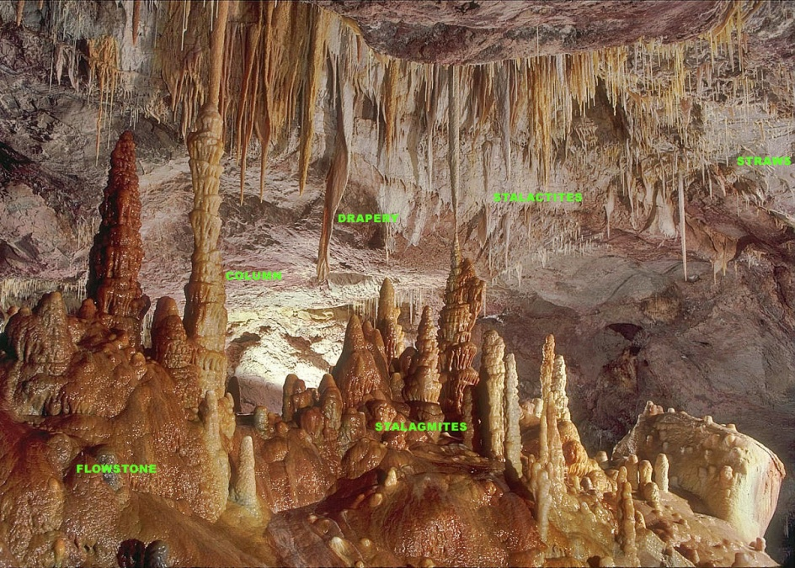
IDC203: IDC:203: Introduction to Earth Sciences

Slide 2
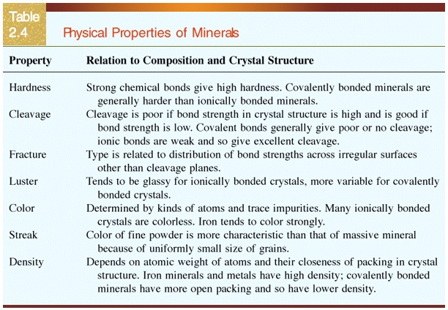

Slide 3
Outline
Rocks
Igneous rock- types and forms
Tectonic settings of Igneous rock formation
Sedimentary rock formation

Slide 4
Rocks
A naturally occurring consolidated mixture of minerals or mineral-like substances
Rocks can be also made up of non mineral matter (e.g., obsidian and coal)
The identity of rock is determined partly by its mineral and partly by its texture.

Slide 5
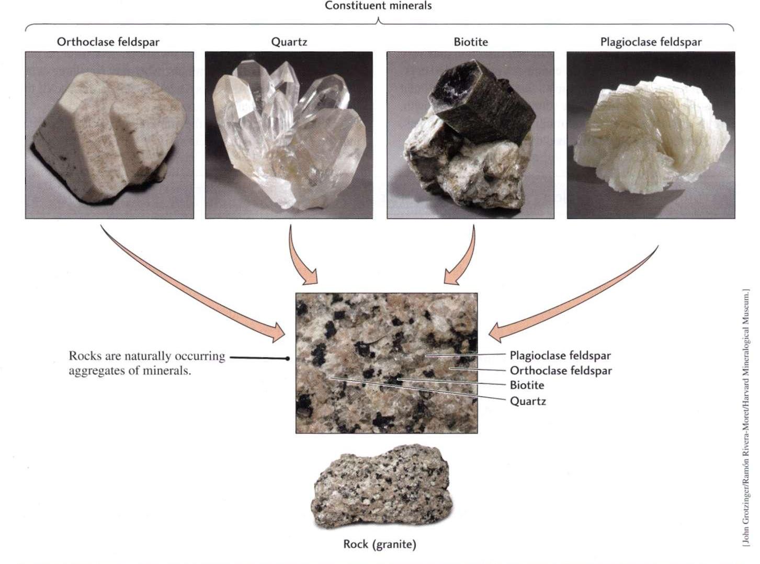
Rocks

Slide 6
Texture
Texture describes size and shapes of a rocks mineral crystals or grains.
The grain large enough to be seen the rock is classified as coarse grained.
The grain not large enough to be seen the rock is classified as fine grained.

Slide 7
Rocks
Rocks formed by solidification of molten rock are called igneous rock
Weathering and erosion of rocks exposed at the surface – sedimentary rocks
Rocks formed under high pressure and temperature in deep crust and upper mantle is metamorphic rocks

Slide 8
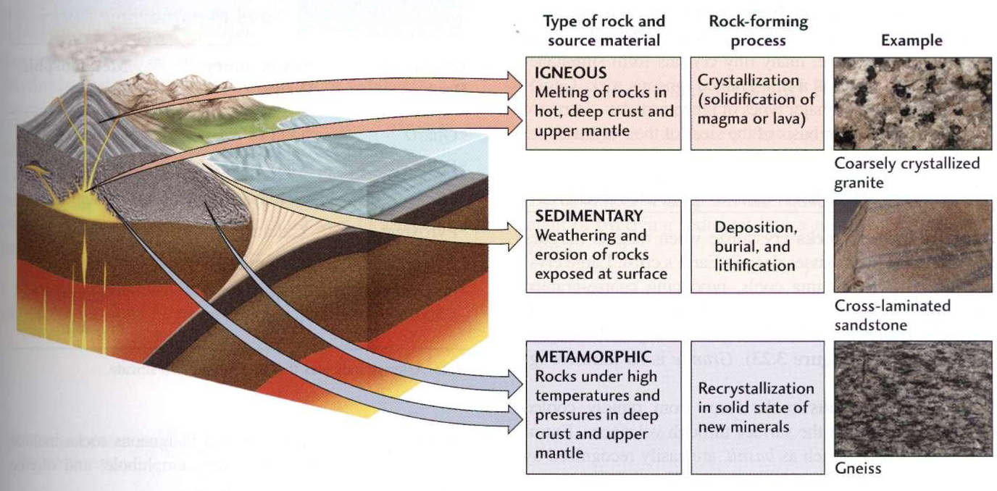
Rocks

Slide 9
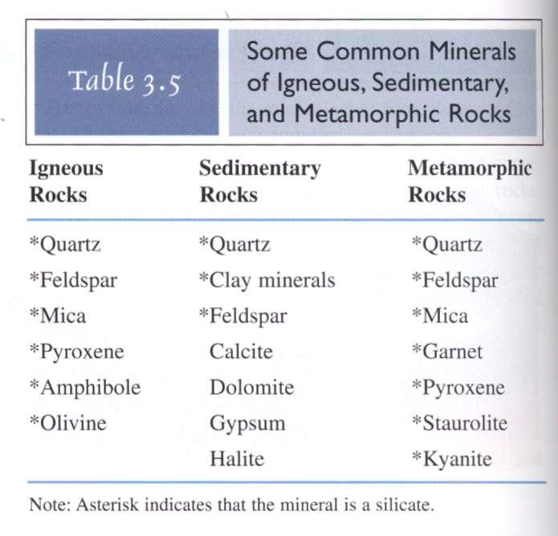
Rocks

Slide 10
Igneous rocks
Formed from the cooling and consolidation of magma
The first division of igneous rocks were made based on the evidences of texture

Slide 11
Clues for early division of igneous rocks
-Volcanic rocks
Laboratory studies of crystallization
Granite as evidence of slow cooling

Slide 12
Texture of igneous rocks
Controlled by cooling rate
Grain size
Degree of crystallinity
Vesicularity

Slide 13
Classification of igneous rocks
Defined by texture:
Fine-grained: extrusive or volcanic
Coarse-grained: intrusive or plutonic

Slide 14
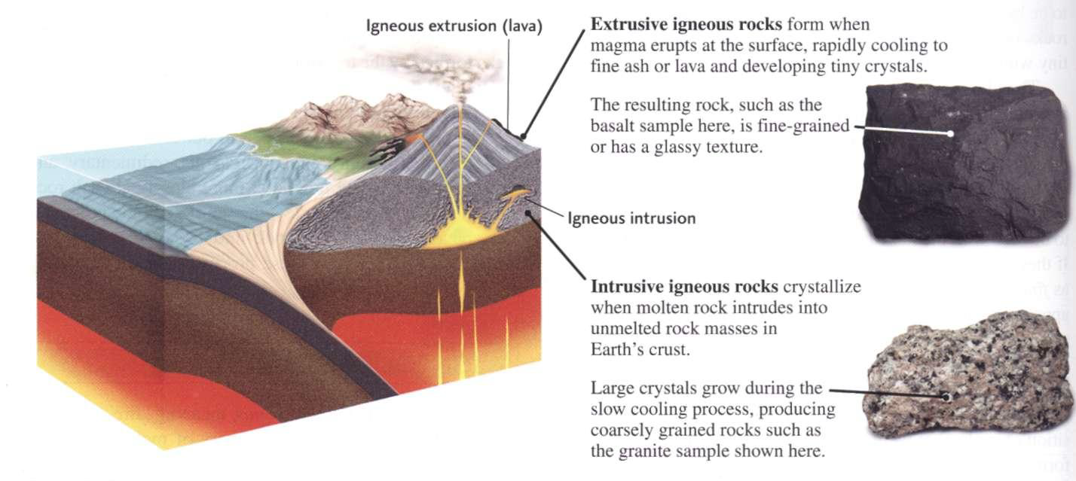
Igneous Rocks
Plutonic (intrusive) — cooled below the surface
volcanic (extrusive) — cooled on the surface

Slide 15
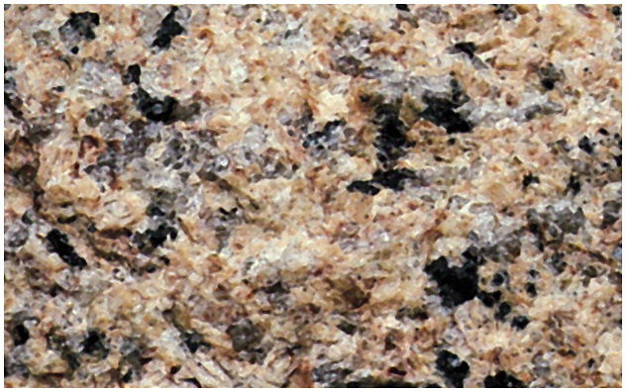
Coarsely crystalline granite

Slide 16
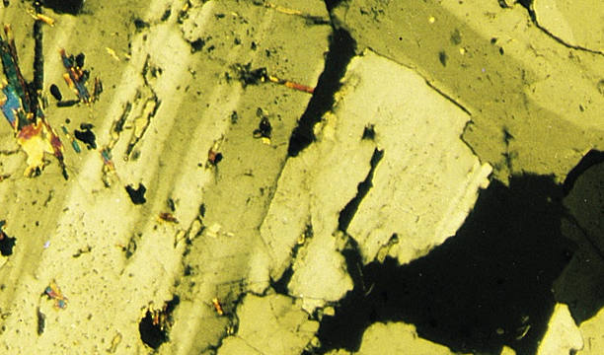
Photomicrograph of Granite
Photomicrograph of granite
Fig. 4.1

Slide 17
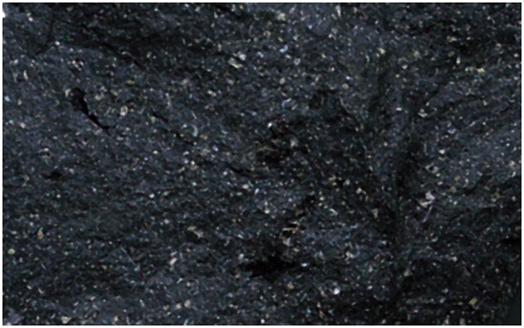
Finely crystalline basalt
Fig. 4.1

Slide 18
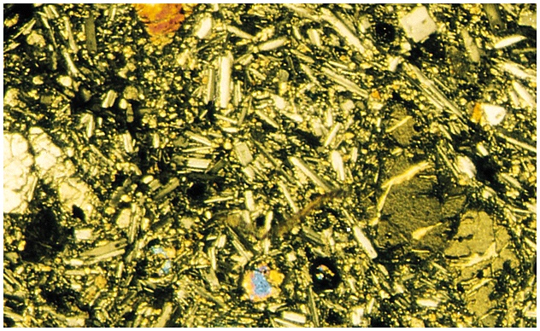
Photomicrograph of basalt
Fig. 4.1

Slide 19
Igneous Classification by texture
Extrusive Intrusive
Basalt Gabbro
Andesite Diorite
Rhyolite Granite

Slide 20
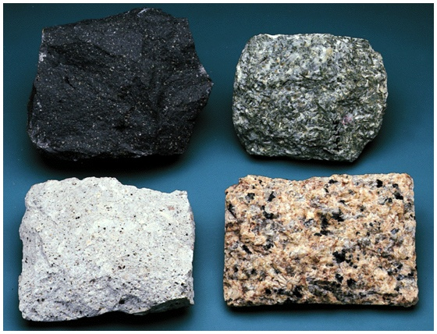
Extrusive
Intrusive
Gabbro
Basalt
Granite
Granite
Rhyolite

Slide 21
Igneous textures
Glassy no minerals present
Crystalline rocks made of mineral grains
Porphyritic mixture of coarse and fine
Vesicular with bubble holes

Slide 22
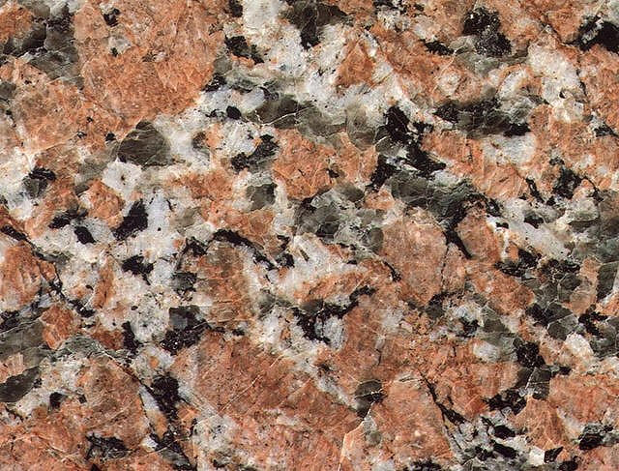
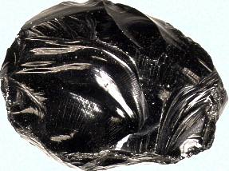
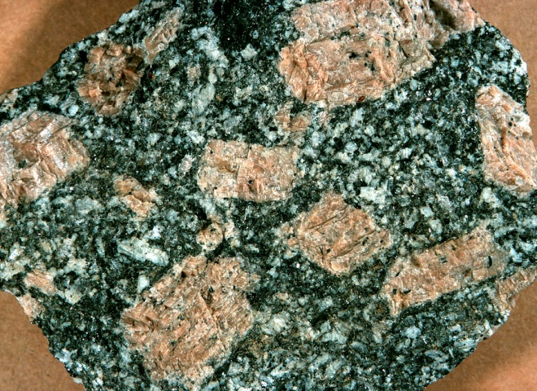
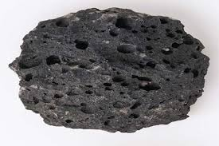
Igneous textures
Glassy
Crystalline
Porphyritic
Vesicular

Slide 23
Classification of igneous rocks
Determined by composition (both chemical and mineralogical)
Magnesium (Mg) + iron (Fe) = Mafic
Feldspar + quartz (Si) = Felsic

Slide 24
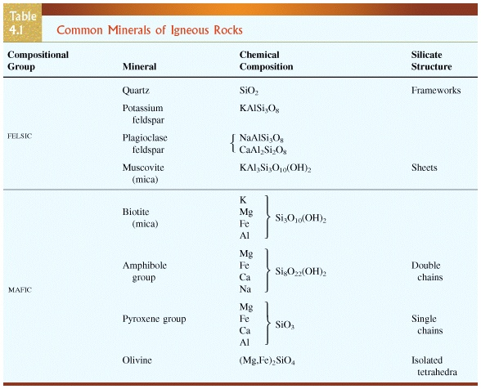
Classification of igneous rocks

Slide 25
Classification of igneous rocks
When we talk about the chemical composition of a rock we usually speak in terms of the oxides, e.g.,
Ty Typical basalt Typical granite
SiO₂ 50% 70%
Al₂O₃ 15% 12%
FeO+MgO 15% 3%
CaO 8% 2%
K₂O+Na₂O 5% 8%

Slide 26
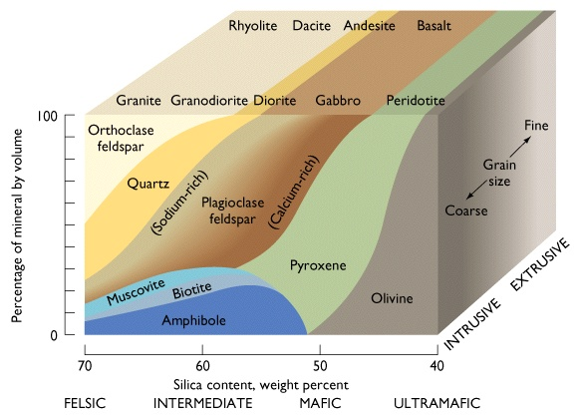
Classification of igneous rocks

Slide 27
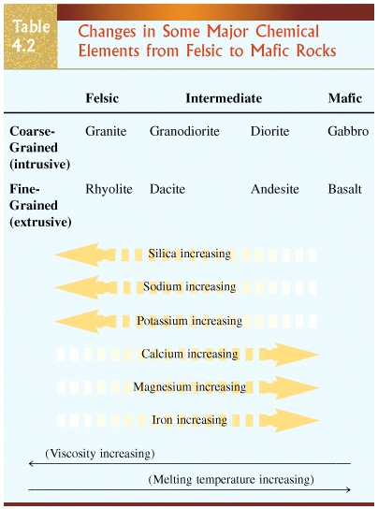
Classification of igneous rocks

Slide 28
How do rocks melt?
Partial melting : the fracture of rock that has melted at given temperature
The temperature at the depth of crust and mantle
Last minerals to form will melt at lowest temperature
Biggest changes will be for small degrees of melting

Slide 29
How do rocks melt?
The pressure due to overburden rocks also affect partial melting
The melting temperature increases with high pressure
Decompression melting: sudden decrease in pressure

Slide 30
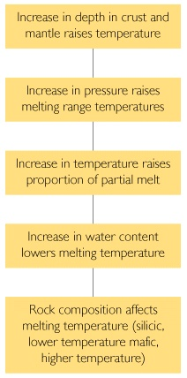
Factors affecting melting temperatures

Slide 31
The formation of magma chamber
The large pools of molten rock form magma chamber
The rise of magmas at rate from 0.3 m/year to almost 50 m/year

Slide 32
Magmatic differentiation
The process by which rocks of varying chemical composition can arise from a uniform parent magma.
This segregation happens in several way following a sequence described as Bowen reaction series

Slide 33
Fractional crystallization
The modification of magma by crystallization and removal of mineral phases.
Because only certain elements will go into a given mineral, this will tend to change the composition of the remaining liquid.

Slide 34
Bowen’s reaction series
Series of chemical reactions that take place in silicate magmas as they cool
First investigated in the 1920s and 1930s by N. L. Bowen
Important experiments that help us understand the evolution of magmas

Slide 35
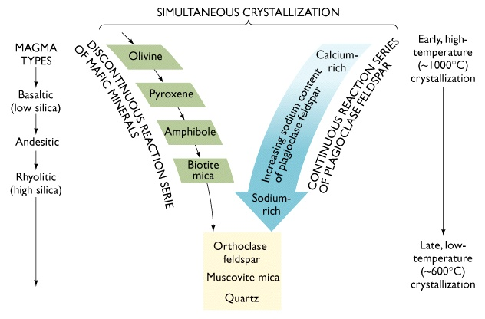
Bowen’s reaction series

Slide 36
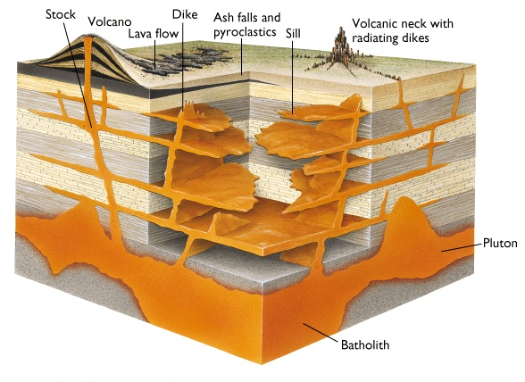
Types of igneous structures

Slide 37
Forms of intrusive igneous masses
Plutons: large igneous bodies formed in deep earth crust
Plutons can be divided into two groups:
1) Concordant
2) Discordant

Slide 38
Forms of intrusive igneous masses
Concordant: Discordant:
Sills Dikes
Batholiths

Slide 39
Forms of intrusive igneous masses
Batholith: Any deep-seated pluton of coarse-grained rocks that has a surface exposure of over 100 sq. km that is mostly granitic. Examples include Sierra Nevada, Coast Range, Idaho batholiths.
Stock: Same as a batholith, only smaller

Slide 40
Forms of intrusive igneous masses
Sills: sheetlike body formed by the injection of magma between parallel layers of bedded country rock.
Dyke: sheetlike body formed by the injection of magma cut across the layers in bedded country rock.

Slide 41
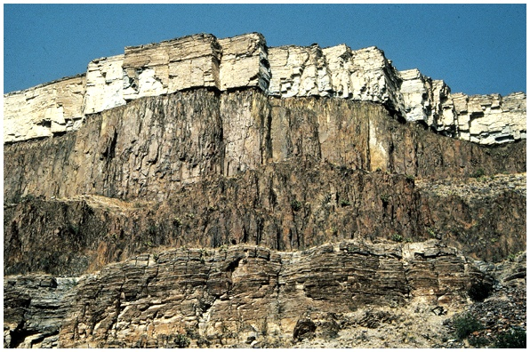
Sill

Slide 42
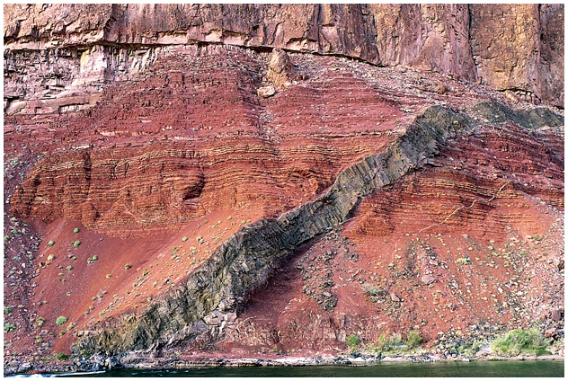
Dike
Fig. 4.16

Slide 43
Forms of intrusive igneous masses
Veins: deposits of minerals found within a rock fracture that are foreign to the country rock.

Slide 44
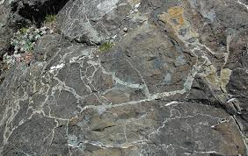
Veins
Monochromatic chert cut by quartz veins

Slide 45
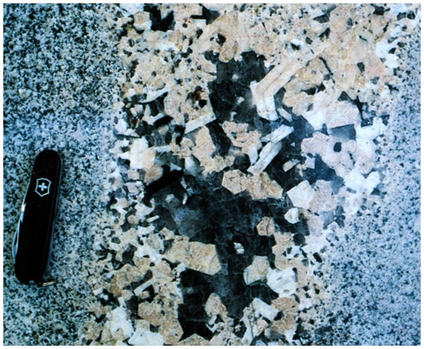
Pegmatite veins
Fig. 4.17

Slide 46
Igneous processes and plate tectonics

Slide 47
Sedimentary rocks
Weathering –Decomposition and disintegration of pre-existing rock into small fragments or new minerals
Transportation of the sediments to a sedimentary basin
Deposition of the sediment
Burial and Lithification to make sedimentary rock

Slide 48
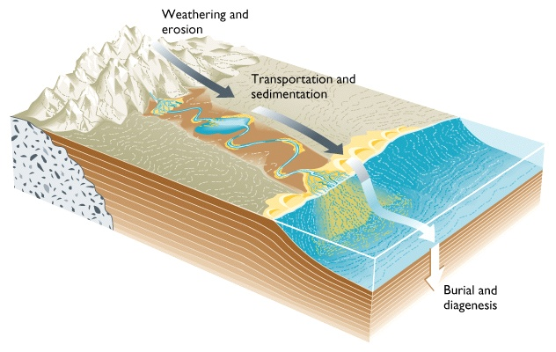
Sedimentary stages in the rock cycle
Fig. 7.1

Slide 49
Sedimentary rocks
Weathering process
Types of sedimentary rocks
Depositional environments

Slide 50
Weathering process
Physical (Mechanical): Large rocks broken into smaller fragments with no change in composition
2. Chemical: Rocks dissolved –
chemical and mineralogical composition can be altered • new minerals may form
3. Biological : plants & animals

Slide 51
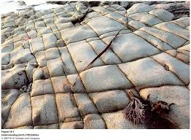
Physical weathering
1. Joints (also termed extensional fractures) are planes of separation on which no shear displacement has taken place

Slide 52
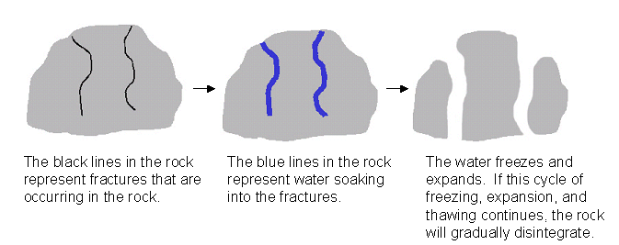
Physical Weathering
2. Frost wedging

Slide 53
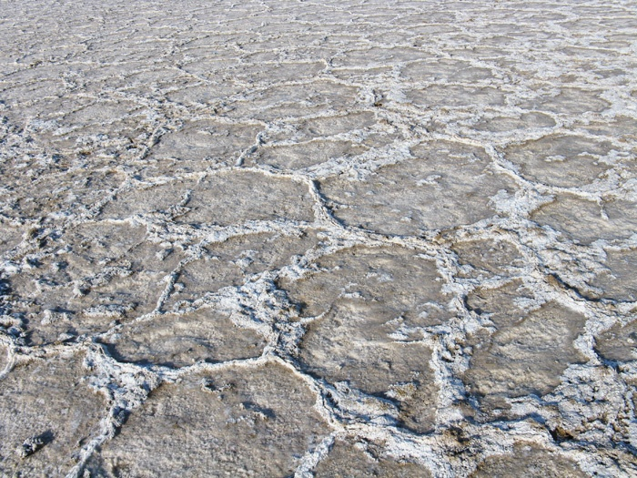
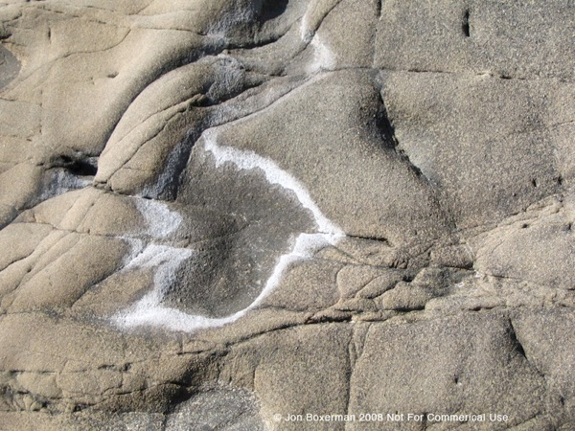
Physical Weathering
3. Salt precipitation

Slide 54
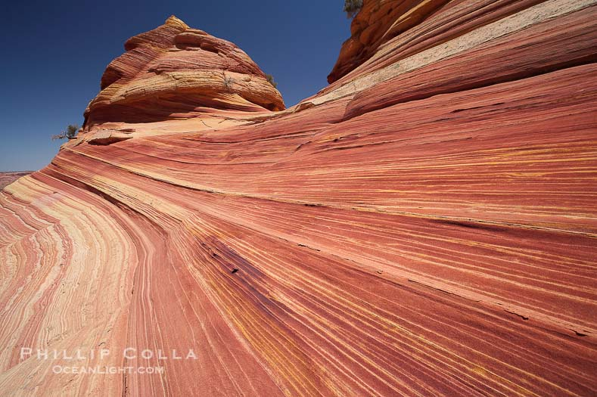
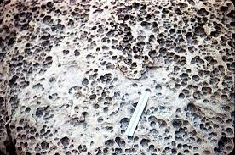
Physical Weathering
4. Abrasion
Physical grinding of rock fragments

Slide 55
Chemical Weathering
Chemical weathering is the weakening and subsequent disintegration of rock by chemical reactions.
These reactions include
Hydration
Hydrolysis
Carbonation

Slide 56
Chemical Weathering
Carbonation is the process of rock minerals reacting with carbonic acid. Carbonic acid is formed when water combines with carbon dioxide. Carbonic acid dissolves or breaks down minerals in the rock.
CO₂ + H₂O → H₂CO₃ (carbon dioxide + water → carbonic acid)
CaCO₃ + H₂CO₃ → Ca²⁺ + 2HCO₃₋ (calcite + carbonic acid → calcium + bicarbonate)

Slide 57
Chemical Weathering
Hydrolysis is a chemical reaction caused by water.
Water changes the chemical composition and size of minerals in rock, making them less resistant to weathering.
2KAISi₃O₈ + 2H⁺ + 9H₂0 → H₄Al₂Si₂O₉ + 4H₄SiO₄ + 2K⁺

Slide 58
Chemical Weathering
Hydration is the absorption of water into the mineral structure.
A good example of hydration is the absorption of water by anhydrite, resulting in the formation of gypsum. Hydration expands volume and also results in rock deformation.

Slide 59
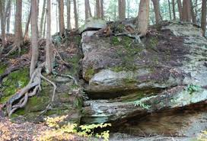
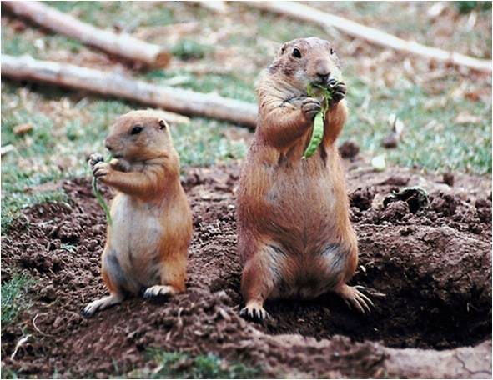
Biological Weathering
This form of weathering is caused by activities of living organism

Slide 60
Factors affect the rates of weathering process
Climate
Structural weakness
Topography
Time
Nature of rocks and minerals

Slide 61
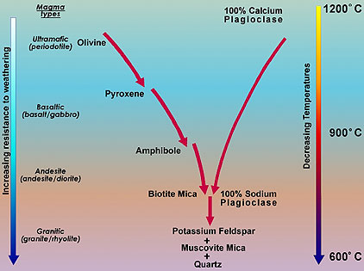
Weathering process

Slide 62
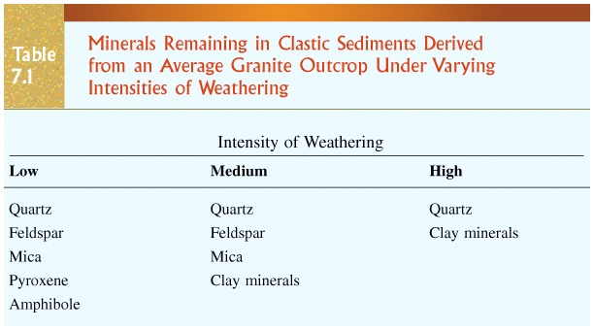

Slide 63
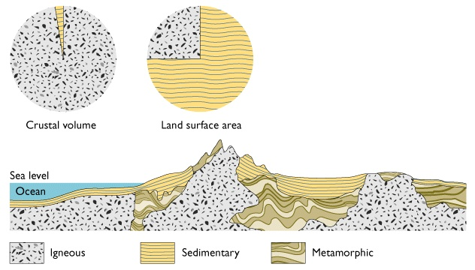
How common are sedimentary rocks?

Slide 64
Sedimentary Rocks
Detrital (clastic) rocks produced from rock fragments
Chemical rocks produced by precipitation of dissolved ions in water
Organic rocks produced by accumulation of biological debris, such as in swamps or bogs
Sedimentary rock types and sedimentary structures within the rocks give clues to past environments

Slide 65
Transport and deposition of Clastic sediments
Movement of sediment by wind, ice or water.
Mode of transport produces distinctive deposits.

Slide 66
Transport affects the sediment in several ways
Sorting: measure of the variation in the range of grain sizes in a clastic rock or sediment
Well-sorted sediments indicate that they have been subjected to prolonged water or wind action.
Poorly-sorted sediments are either not far-removed from their source or deposited by glaciers.

Slide 67
Sorting
Well-sorted
Poorly-sorted

Slide 68
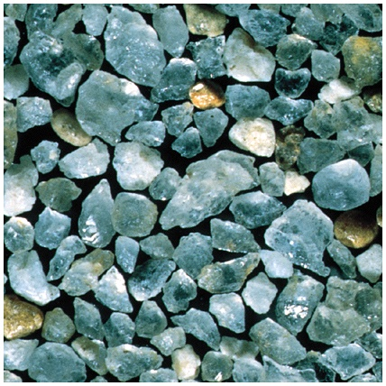
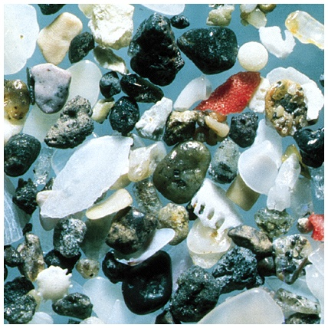
Well-sorted sand
Poorly-sorted sand

Slide 69
Transport affects the sediment in several ways
Roundness: measure of how rounded the corners are
Sphericity: measure of how much it is like a sphere
Sorting, roundness, and sphericity all increase with amount of transport.

Slide 70
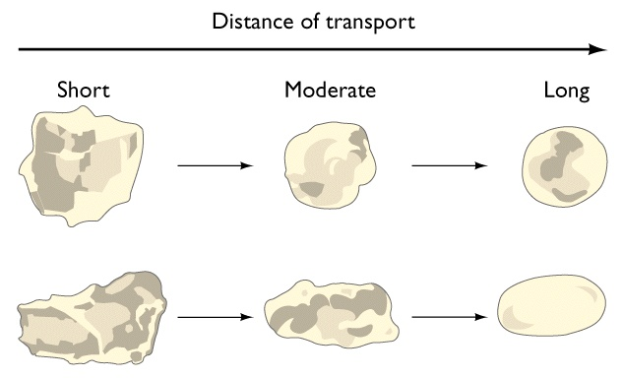
Roundness and sphericity

Slide 71
Types of detrital rocks
Largely based on the size of the particles, which may be anything.
Sediment -classified by particle size
Boulder - >256 mm
Cobble - 64 to 256 mm
Pebble - 2 to 64 mm ----
Sand - 1/16 to 2 mm
Silt - 1/256 to 1/16 mm
Clay - <1/256 mm
Gravel

Slide 72
Types of detrital rocks
Conglomerate
Breccia
Sandstone (quartzite, arkose, greywacke)
Shale
Mudstone
Siltstone

Slide 73
Clastic sedimentary rocks
Breccia and Conglomerate
Coarse-grained clastic sedimentary rocks
Sedimentary breccia composed of coarse, angular rock fragments cemented together
Conglomerate composed of rounded gravel cemented together

Slide 74
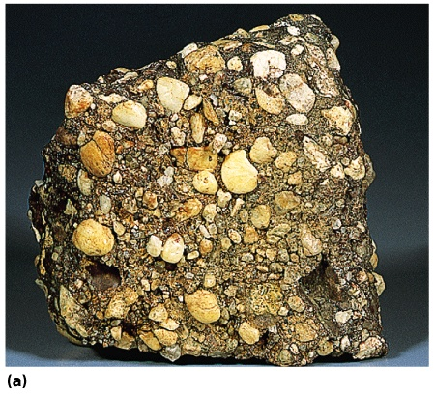
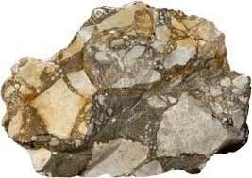
Conglomerate
Breccia
Fig. 7.15a
Breck Kent

Slide 75
Clastic sedimentary rocks
Sandstone
Medium-grained clastic sedimentary rock
Types determined by composition
Quartz sandstone - >90% quartz grains
Arkose - mostly feldspar and quartz grains
Graywacke - sand grains surrounded by dark, fine-grained matrix, often clay-rich

Slide 76
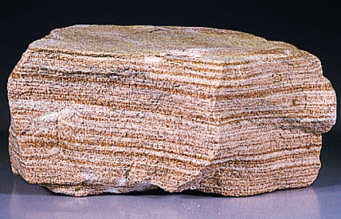
Sandstone
Fig. 7.15b
Breck Kent

Slide 77
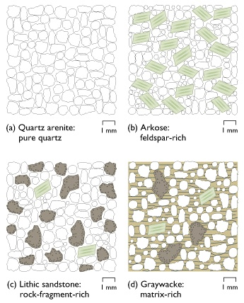
Four major groups of sandstones

Slide 78
Shale
Shales are clastic rocks, made up mainly fine silt/clay
They are most abundant sedimentary rocks, accounts for about 80% of them
Often contain fossils
Mostly hydrous aluminum silicate in composition = from weathered feldspars
Deposition takes place under low fluvial regime or under weak water current. Eg. Offshore or in Lagoon
Shales are made of fine well sorted silt and clayey sediments, where normally one can expect high porosity and permeability.

Slide 79
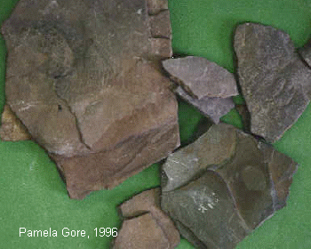
Shale

Slide 80
Types of chemical sedimentary rocks
Limestone CaCO₃
Chert SiO₂
Salt NaCl, KCl, K₂SO₄
Gypsum CaSO₄ • 2H₂O
Coal altered organic debris

Slide 81
Chemical sedimentary rocks
Carbonates
Contain CO₃ as part of their chemical composition
Limestone is composed mainly of calcite
Most are biochemical, but can be inorganic
Often contain easily recognizable fossils

Slide 82
Chemical sedimentary rocks
Limestone: It is a non-clastic rock formed either chemically or due to precipitation of calcite (CaCO₃) from organisms usually shell. These remains will result in formation of a limestone.
Limestones formed by chemical precipitation are usually fine grained, whereas, in case of organic limestone the grain size vary depending upon the type of organism responsible for the formation
Fossiliferous Limestone: which medium to coarse grained, as it is formed out of cementation of Shells.

Slide 83
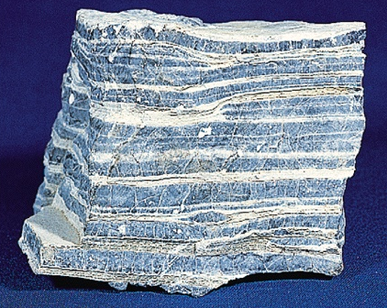
Limestone
Fig. 7.19a

Slide 84
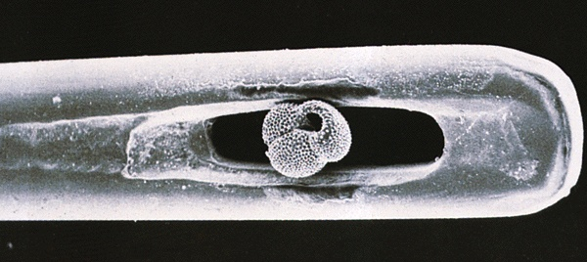
Foraminifera in the eye of a needle
Fig. 7.17

Slide 85

Fossiliferous limestone

Slide 86

Chemical sedimentary rocks
Chert
Hard, compact, fine-grained, formed almost entirely of silica
Can occur as layers or as lumpy nodules within other sedimentary rocks, especially limestones

Slide 87
Evaporites
These rocks are formed within the a depositional basin from chemical substances dissolved in the seawater or lake water
Characteristic of arid conditions

Slide 88


Evaporites
Minerals precipitate according to solubility.
Gypsum Halite
50% 90%
CaSO₄.2H₂0
NaCl

Slide 89

Relative abundance of sedimentary rock types

Slide 90
Sedimentary environment
Sediments accumulate in some environment of deposition or depositional environments
These areas receive net deposition
Erosion may occur, but deposition dominates
Features of these depositional environments are preserved in the rock record
Examples:
Sediment texture
Fossils of organisms that lived in the environment
Ancient environments can be reconstructed from the clues that are preserved in the sedimentary rocks

Slide 91

Common sedimentary environments

Slide 92

Characteristics of a sedimentary environment

Slide 93


Slide 94


